Slide 1
5-Day International Workshop on
“Recent Advances in Semiconductor and Emerging Devices for Chip Design”
Presents Talk on
Multi-Phase clock generators for Next-Gen High-Performance Communications Systems
Neeraj Mishra
Faculty Member
EEE Department
BITs Pilani, Pilani Campus

Slide 2
Bio-Sketch
Name: Neeraj Mishra
Faculty Member: EEE Department BITs Pilani, Pilani Campus. (4 Dec 24-) QS World = 668th Rank, QS EEE=250-300 Rank
Senior Researcher: Analog Mixed Signal IC Designer focus on high speed CMOS Design at ID Lab of imec & Ghent University Belgium (1 April 2023-20 Nov 2024)
Post-Doc: ADVISE Group, ESAT Department, KU Leuven ( Nov 2021-Nov 2022). (QS World = 60th Rank, QS Electrical & Electronics =39th Rank).
Research Topic: Radiation-hardened Time-to-Digital Conversion (RADTIME).
Advisor: Prof. dr. ir. Paul Leroux.
PhD : IIT Roorkee (Visvesvaraya PhD Scheme for Electronics & IT) (Dec-2015-Oct- 2021). (QS World = 369th Rank, QS Electrical & Electronics = (150-200)^{th} Rank)
Research Topic: High-Performance Ring Oscillator Using Separately Driven Inputs.
Advisor: Prof. Anand Bulusu.
M Tech : IIT Roorkee (2013-2015). (Gate Rank 346 in ECE)
Research Topic: Mechanical Stress aware design and layout of basic Analog building blocks.
Advisor: Prof. Anand Bulusu.
Job : (a) Engineer in Alcatel and Lucent Managed Solution Limited. (March 10 - May 13).
(b) Engineer in Railtel Corporation of India Limited (PSU Under Ministry of Railways). (June 08 - Feb 10).

Slide 3
Key Publications/Proposals
As a First Author
Neeraj Mishra, Anchit Proch, Lomash Acharya, S. Chakraborty, and B. Anand, “Generalized Edge Propagation and Multi-Band Frequency Switching Mechanism for MSSROs” IEEE Transactions on Circuits and Systems II: Express Briefs vol. 70, no. 9, pp. 3609-3613, Sept. 2023 doi: 10.1109/TCSII.2023.3267384. (IF 4.4).
Neeraj Mishra, Anchit Proch, Lomash Acharya, Jeffrey Prinzie, Sudipto Chakraborty, Rajiv Joshi Sudeb Dasgupta, and B. Anand, “Phase-noise analysis of Separately Driven Ring Oscillators” IEEE Transactions on Circuits and Systems I: Regular Papers vol. 69, no. 11, pp. 4415-4428, Nov. 2022, doi: 10.1109/TCSI.2022.3196820. (Appeared In top 50 Popular Articles). (IF 5.2).
Neeraj Mishra, L. M. Dani, S.Chakraborty, R. V. Joshi and A. Bulusu, "Delay Modulation in Separately Driven Delay Cells Utilized for the Generation of High-Performance Multiphase Signals Using ROs," in IEEE Transactions on Circuits and Systems II: Express Briefs, vol. 69, no. 1, pp. 30-34, Jan. 2022, (Appeared In top 50 Popular Articles). (IF 4.4).
Neeraj Mishra, L. M. Dani, K. Sanvaniya, S. Dasgupta, S. Chakraborty and A. Bulusu, "Design and Realization of High-Speed Low-Noise Multi-Loop Skew-Based ROs Optimized for Even/Odd Multi-Phase Signals," in IEEE Transactions on Circuits and Systems II: Express Briefs, vol. 67, no. 11, pp. 2352-2356, Nov. 2020. (IF 4.4).
Neeraj Mishra, Lomash Acharya, Anchit Proch, Sudipto Chakraborty, Sudeb Dasgupta, and B. Anand, “Variation aware Switching current model for the efficient design of separately driven ring oscillators” IEEE Transactions on Circuits and Systems I: Regular Papers (To be submitted).
Proposal Accepted IEEE Solid State Circuits Society (SSCS) Plateform for IC design Outreach (PICO) Design Contest
Anchit Proch, Neeraj Mishra, and B. Anand, “A Wide-Range High-Performance Noise Suppressing Skew-Based Multi-Loop VCRO architecture, Proposal Accepted in IEEE SSCS PICO Design Contest, In which the society provides the Test Chip Fabrication facility. Out of 65 submissions from throughout the globe, 18 were accepted. We will submit this work to the "IEEE Journal of Solid-State Circuits" after measurement (Under process) of a test chip in the 180nm SCL PDK and 130nm SkyWater Technology PDK (Open Source).
As a Co-Author
S. Srivastava, S. Panwar, M. Shashidhara, L. Chandra, Neeraj Mishra and A. Acharya, "Influences of Source/Drain Extension Region on Thermal Behavior of Stacked Nanosheet FET," in IEEE Transactions on Electron Devices, vol. 71, no. 3, pp. 2171-2176, March 2024 . (IF 3.1).
Lomash Chandra Acharya, Khoirom Johnson Singh, Neha Gupta, Mahipal Dargupally, Neeraj Mishra, Arvind Sharma, Abhishek Acharya, Venkatraman Ramakrishnan, Ajoy Mandal, Sudeb Dasgupta, Anand Bulusu, Prediction of variation aware FOSC in ring oscillators (ROs) to mitigate the impact of aging on RO-PUF, Solid-State Electronics, Volume 210, 2023, 108790, ISSN 0038-1101. (IF 1.96).
L. C. Acharya, A. K. Sharma, Neeraj Mishra, K. J. Singh, M. Dargupally, N. S. Shabarish, A. Mandal, V. Ramakrishnan, S. Dasgupta and A. Bulusu, "Aging-Aware Timing Model of CMOS Inverter: Path Level Timing Performance and Its Impact on the Logical Effort" in IEEE Transactions on Computer-Aided Design of Integrated Circuits and Systems. vol. 42, no. 8, pp. 2657-2663, Aug. 2023 (IF 2.9).
L. M. Dani, Neeraj Mishra and B. Anand, "A Variation Aware Jitter Estimation Methodology in ROs Considering Over/Undershoots in NTV Regime," in IEEE Transactions on Circuits and Systems II: Express Briefs, vol. 69, no. 3, pp. 1557-1561, March 2022. (IF 4.4).
L. M. Dani, Neeraj Mishra and A. Bulusu, "An Efficient and Accurate Variation-Aware Design Methodology for Near-Threshold MOS-Varactor-Based VCO Architectures," in IEEE Transactions on Computer-Aided Design of Integrated Circuits and Systems, vol. 40, no. 10, pp. 2117-2127, Oct. 2021. . (IF 2.9).
L. M. Dani, Neeraj Mishra, A. Sharma, and A. Bulusu, "Variation-Aware Prediction of Circuit Performance in Near-Threshold Regime Using Supply-Independent Transition Threshold Points," in IEEE Transactions on Electron Devices, vol. 66, no. 12, pp. 5065-5071, Dec. 2019. (IF 3.1).
L. Dani, Neeraj Mishra and B. Anand, "MOS Varactor RO Architectures in Near Threshold Regime Using Forward Body Biasing Techniques", 2019 32nd International Conference on VLSI Design and 2019 18th International Conference on Embedded Systems (VLSID), Delhi, NCR, India, 2019, pp. 41-45.
L. M. Dani, Neeraj Mishra, S. K. Banchhor, S. Miryala, A. Doneria and B. Anand, "Design and Characterization of Bulk Driven MOS Varactor based VCO at Near Threshold Regime", 2018 IEEE SOI-3D-Subthreshold Microelectronics Technology Unified Conference (S3S), Burlingame, CA, USA, 2018, pp. 1-2.

Slide 4
Research Motivation
Key Highlights
Requirement of high-speed multi-phase clock generation for achieving high performance systems.
Key Outcomes
Purpose: Multi-phase clock generators (MPCGs) play a pivotal role in local clock generation within each transceiver lane. They create multi-phase sampling clocks to enhance the sampling rate or generate multi-phase input clocks for phase interpolators (PIs).
Trade-offs: Conventional techniques face trade-offs between Phase Noise, power consumption, and phase accuracy.
  In summary, the pursuit of high-speed, high-performance systems necessitates innovative clocking solutions that balance accuracy, power efficiency, and linearity in multi-phase clock generation.

Slide 5
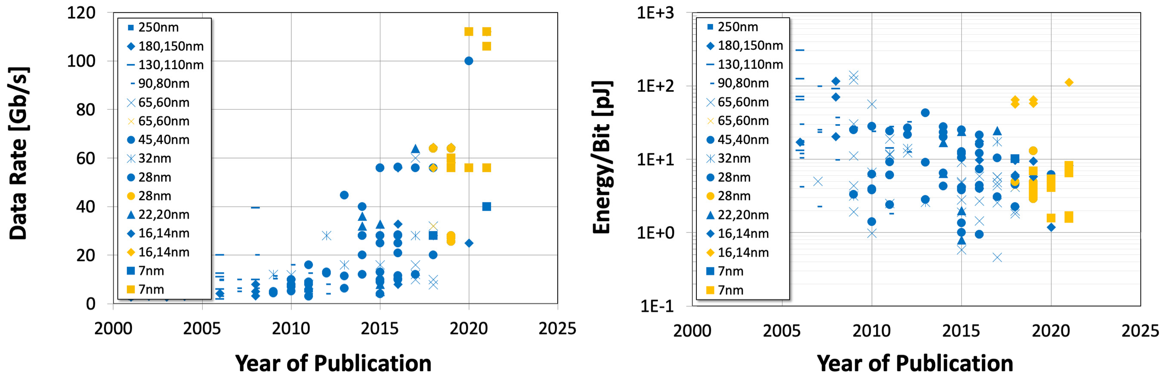
Trend of Ever-Increasing Data Rate
28nm: NRZ
28nm: PAM4
PAM4 based transceivers drive the data rate beyond 100GBit/s
7nm CMOS technology enables power-efficiency <10pJ/conv.
Details of the wireline transceiver survey

Slide 6
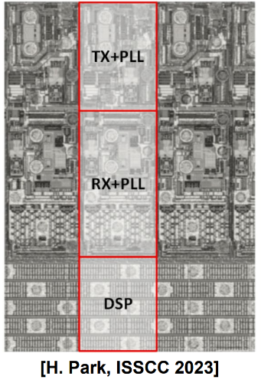
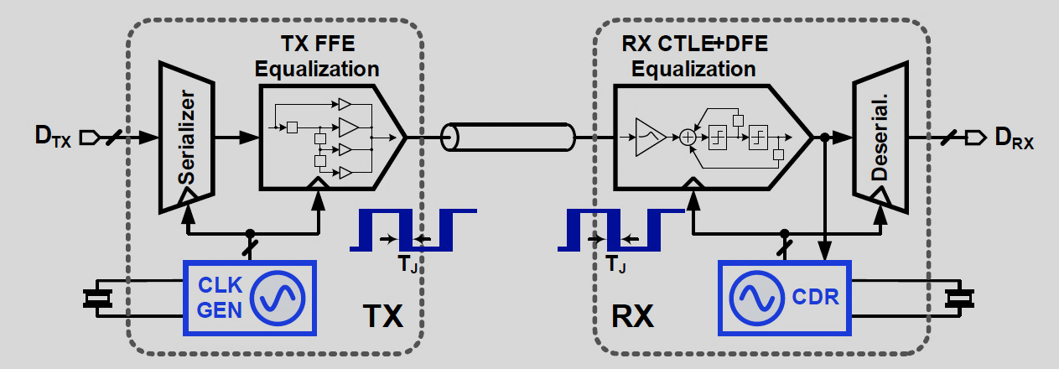
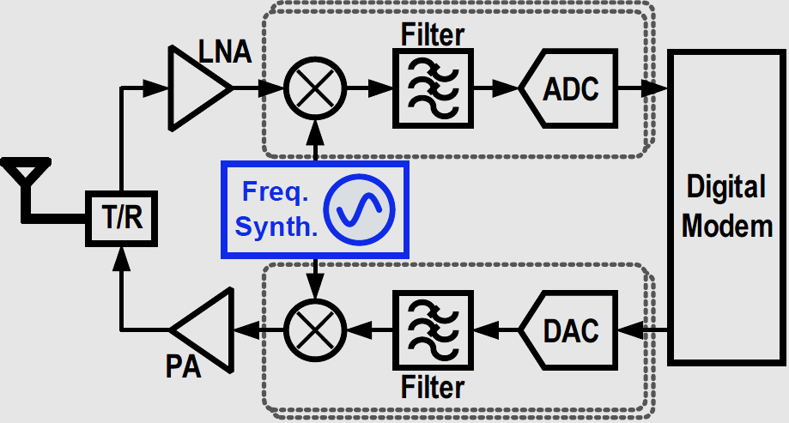
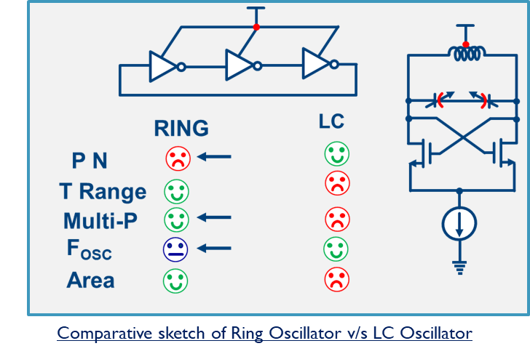
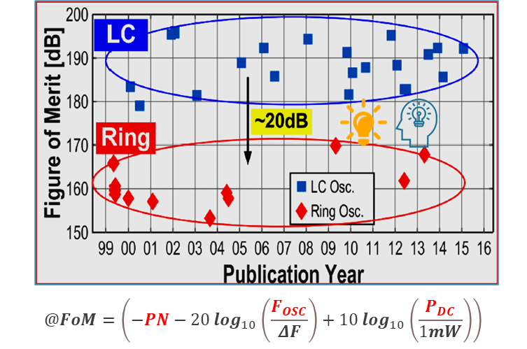
Motivation
Block diagram of a serial link with embedded clocking
Block diagram of a typical wireless transceiver
Typical serial link architecture with embedded clocking used in data centre networks.
At the transmitter, a parallel data stream is serialized using a high-frequency clock.
A clock generator synthesizes this clock relying on an external crystal reference clock.
The receiver’s CDR retrieve the clock and data from the equalized signal.
Clock generation at TX and clock and data recovery (CDR) at RX require 35-50% of a link's power.
The frequency synthesiser synthesizes the RF carrier and down-conversion signal at the receiver.
Synthesizers require 50% of transceiver power, and the rest is consumed by the CPU; mobile platforms include audio data converters and memory-required clocks.
Clock and frequency synthesisers play a key role and limiting their performance and power.
Wireline transceivers require many PLLs
LC-PLLs are used for low jitter BUT…
1) Susceptible to electromagnetic coupling
2) Narrow frequency range
3) `Mostly provide two phases

Slide 7
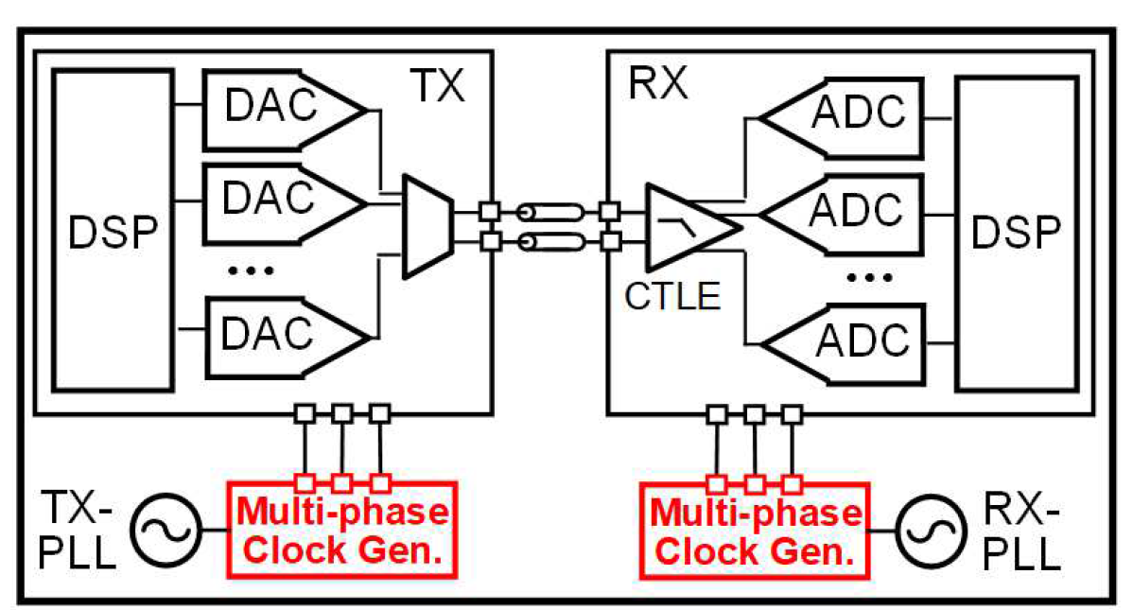
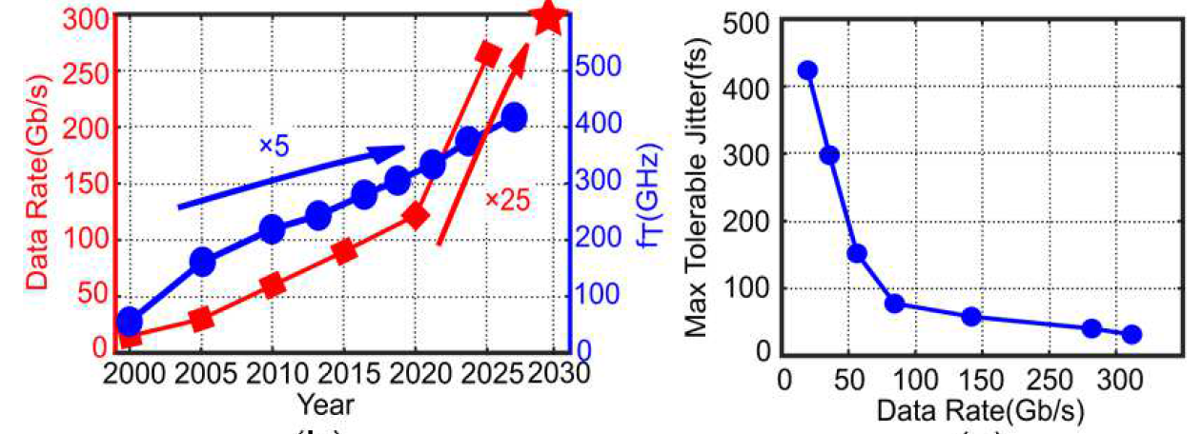
Problem Context and Motivation
Multi-phase clocks are critical for ADC/DAC-based wireline transceivers.
As data rates rise, the need for accurate clock phases and low jitter becomes paramount.
The growing data rate increases the challenge due to the finiteness of transistor speed (f_{tr}), and clock circuit jitter needs to be minimized
ADC/DAC data rate evolution over past 20 years (rising trend).
Jitter vs. data rate—shows technological constraints with respect to allowable jitter at high data rates.

Slide 8
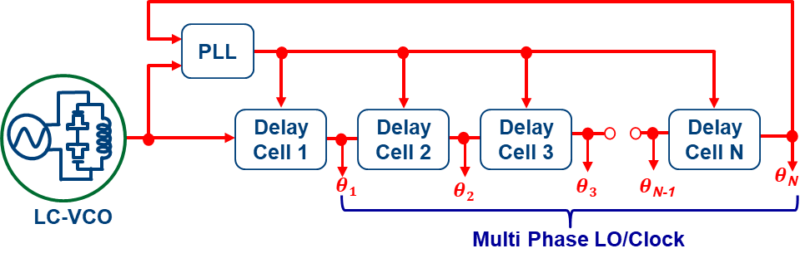






Techniques for clock generation and its requirements for High-Performance circuits
State-of-the-art strategies for synthesizing precisely controlled multiphase clock and LO signals—core components in high-speed data converters, wireline /wireless transceivers, and timing-critical digital systems.
The approaches blend PLLs, DLLs, ROs, and LC-VCOs to address the multifaceted trade-offs among jitter, phase accuracy, integration density, and spectral purity demanded by next-generation SoCs.
Ring
Oscillator
$$θ1$$
$$θ2$$
Multi
Phase
LO/Clock
Phase-
Locked
Loop
$$θ3$$
LC-VCO
$$θ1$$
Phase-
Locked
Loop
$$θ2$$
Multi
Phase
LO/Clock
$$θN$$
LC-VCO
LC-VCO
$$θ3$$
LC-VCO
$$θN$$
(a) Multiphase LO/clock generation methods using Ring with inverters
(b) Multiphase LO/clock generation using LC VCOs
Phase-
Locked
Loop
Frequency
Divider
$$θ1$$
$$θ2$$
$$θ3$$
$$θN$$
LC-VCO
Multi Phase
LO/Clock
(c) Multiphase LO/clock generation methods using
LC VCOs and frequency divider
(d) Multiphase LO/clock generation methods using Ring
with LC VCOs and DLL

Slide 9
Multiphase Generation deep dive
Ring
Oscillator
$$θ1$$
$$θ2$$
Multi
Phase
LO/Clock
LC-VCO
$$θ1$$
Phase-
Locked
Loop
$$θ3$$
Phase-
Locked
Loop
$$θ2$$
LC-VCO
LC-VCO
$$θ3$$
Multi
Phase
LO/Clock
$$θN$$
LC-VCO
$$θN$$
(a) Multiphase LO/clock generation methods using Ring with inverters
(b) Multiphase LO/clock generation using LC VCOs
A classic ring oscillator, comprising an odd number of inverters arranged in a loop, is locked to a reference via a PLL to enhance long-term frequency stability.
The circuit naturally produces evenly spaced clock phases (θ₁,θ₂,...,θ_{N}), making it ideal for low-area multiphase generation.
However, intrinsic device noise, sensitivity to PVT (process, voltage, temperature) variation, and limited Q-factor result in elevated phase noise and jitter—constraining utility in precision RF or low-jitter ADC/DSP domains.
Multiple cross-coupled LC-VCOs form a closed ring topology, with a PLL governing the center frequency.
Mutual coupling of high-Q resonant tanks generates low-jitter, spectrally pure, and equally spaced multi-phase outputs.
This topology is a mainstay in multi-gigabit serial links and mmWave radios where phase fidelity and low RMS jitter are paramount.
The primary trade-offs are silicon area overhead from on-chip inductors and increased design complexity due to coupling and startup dynamics.

Slide 10
Phase-
Locked
Loop
Frequency
Divider
$$θ1$$
$$θ2$$
$$θ3$$
$$θN$$
LC-VCO
Multi Phase
LO/Clock
(c) Multiphase LO/clock generation methods using
LC VCOs and frequency divider
(d) Multiphase LO/clock generation methods using Ring
with LC VCOs and DLL
This scheme leverages a single, high-performance LC-VCO locked by a PLL.
A frequency divider electronically synthesizes the required number of equidistant clock or LO phases.
This method delivers excellent jitter performance and robust immunity to supply and substrate interference, at the cost of additional propagation delay and division artifacts, constraining minimum attainable clock granularity and limiting very high phase-count implementations.
Combines the low-jitter drive of an LC-VCO (locked by PLL) with a cascade of digitally controlled delay cells in a DLL configuration.
This architecture provides ultra-fine granularity in phase spacing and fast, deterministic phase alignment—critical for time-interleaved ADCs and phase array systems.
While offering exceptional phase matching and flexibility, it demands precise delay calibration, introduces higher power overhead, and necessitates sophisticated control and monitoring circuitry.

Slide 11
Comparative Table: Advanced Multiphase Clock
Generation
Architecture | Jitter/Phase Noise | Silicon Area | Phase Accuracy | Integration | Scalability | Remarks
Ring Oscillator | High | Compact | Moderate | Excellent | Easy | Popular for digital SoCs, but limited for RF/precision analog
LC-VCO Ring | Ultra-low | Large | Excellent | Challenging | Moderate | De facto for RF front-ends, SerDes, mmWave
LC-VCO Divider | Low | Moderate | Good | Good | Moderate | Robust, divider non-idealities at lower fclk
DLL + LC-VCO | Low | High | Superior | Complex | Excellent | Time-interleaved ADCs, phase arrays, calibration intensive

Slide 12
Advanced Insights
Jitter & Phase Noise Performance: LC-VCO-based solutions are unrivaled in achieving sub-ps jitter and >100 dB SNR clock generation, making them the gold standard for wireline SerDes and mmWave phased arrays.
PVT Robustness: PLL/DLL hybrid architectures enable dynamic on-chip compensation for environmental variation, facilitating robust, process-agnostic timing across advanced CMOS nodes.
Integration vs. Performance: While ring-oscillator schemes are highly amenable to digital SoCs due to compact area and design modularity, advanced LC architectures with on-chip passives represent the convergence point for analog-digital-mixed ICs seeking both spectral purity and phase coherence.
Scalability Trends: As clock speeds and phase count requirements escalate in emerging RF and high-speed data protocols, hybrid and divider-assisted topologies increasingly define the trajectory of research and industrial implementation.
Summary:
Each multiphase clock generation paradigm addresses distinct requirements in high-performance IC design. Judicious method selection—grounded in quantitative trade-off analysis and target application context—serves as a cornerstone for best-in-class timing and signal integrity in next-generation electronic platforms.

Slide 13
Introduction to High-Speed Data Conversion
Modern receivers demand both high data throughput and wide dynamic range.
Traditional single-core ADCs cannot simultaneously achieve high sampling rates and high SNR.
Technology trend: Parallelization through interleaving for bandwidth scaling.
What is Interleaving in ADCs?
Splits conversion across multiple lower-rate ADCs working in parallel.
Effective sampling rate = N×f_{core} where N is number of sub-ADCs.
Each core is clocked by a phase-shifted version of the master clock.

Slide 14
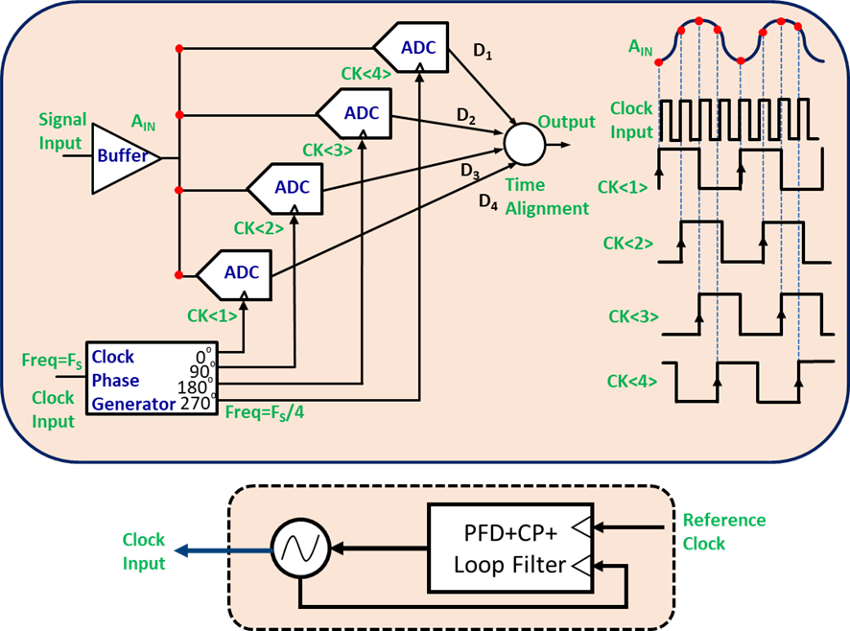
Four-Way Time Interleaved ADC Architecture
Four parallel ADCs; clock inputs CK<1> to CK<4> staggered by 90°.
Input sampling is distributed; each core processes one in four samples.
Outputs time-aligned and merged into a single, high-rate data stream.
Aspect | Interleaved ADCs | Single-Core ADCs
Throughput | Very high (scalable) | Limited
Power Efficiency | Higher at multi-GSps | Lower at multi-GSps
Channel Matching | Needs calibration | Intrinsic
Design Complexity | High | Moderate
Area | Lower per GSps | Higher

Slide 15
Clocking and Synchronization
Multiphase clock generation typically by PLL or DLL circuits for precision phase alignment.
Clock integrity crucial: phase skew and jitter directly impact performance.
Block diagram: Show PLL generating all four phase clocks.
Performance Advantages
Enables multi-GSps sampling using moderate-speed ADC cores.
Power efficiency: Parallelism reduces per-channel speed requirement, enabling lower power operation.
Scalable: Architecture expands easily to 8, 16, or more channels.

Slide 16
Technical Challenges
Inter-channel mismatches:
  Gain, offset, and especially timing skew induce spurs.
Data alignment logic needed at digital output.
Demands comprehensive background calibration (DSP-based) for high linearity.
Clock generation and distribution become critical bottlenecks at high N.
Calibration & Digital Correction
Modern systems implement real-time DSP correction for:
  Gain mismatch
  Offset mismatch
  Timing skew/jitter
Enables sustained high ENOB, even under process/drift variations.
Time-interleaved ADCs are foundational for next-generation giga sample bandwidth in compact, efficient SoCs.
Clocking strategy, calibration, and digital correction are enablers of exceptional performance.
Architecture aligns with industry shifts toward multi-functional, broadband, software-defined platforms

Slide 17
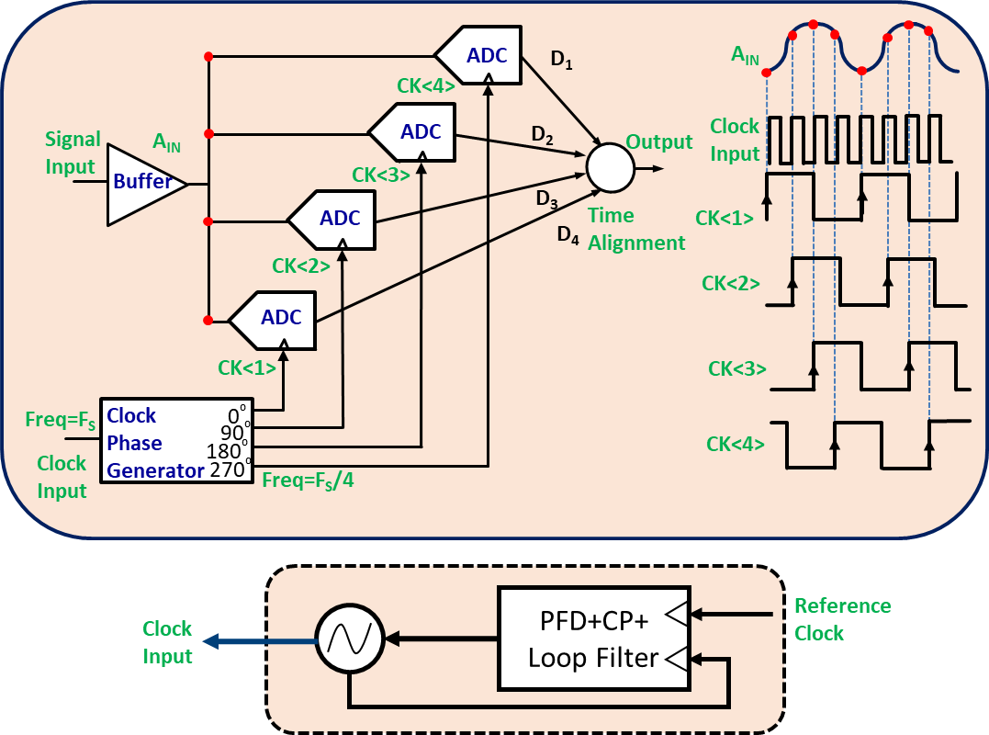
Four-way interleaved Analog-to-Digital Converter
Working Principle
At the heart of the interleaved ADC is the distribution of input sampling across multiple parallel ADC cores—here, four sub-ADCs—each clocked at a phase-shifted clock signal (CK₁ to CK₄). The clock signals are generated using a clock phase generator, often realized via a precision PLL-based multiphase clock source, which outputs N=4 clock phases offset by 90° intervals.
Input Buffering and Data Path:
The analog input A_{IN} is buffered and simultaneously routed to the sample-and-hold stages of all four ADC cores. Each core samples the same analog signal at periodic intervals, but those intervals are staggered such that each converter operates at F_{S}/4, where F_{S} denotes the desired overall sampling rate.
This details the operational principle and architectural organization of a four-channel time-interleaved ADC system, designed to deliver the high-throughput, high-dynamic-range performance demanded by advanced communication receivers and mixed-signal front-ends.

Slide 18
Four-way interleaved Analog-to-Digital Converter
Sampling Phases:
  Each ADC receives a unique clock phase, ensuring the sampling instants T₁,T₂,T₃,T₄ are equally spaced within a single period F_{S}−1. This subdivides the input’s time axis, allowing interleaved conversion and higher aggregate sample throughput.
Data Alignment Logic:
  Parallel digital outputs (D₁,D₂,D₃,D₄) are time-aligned and dynamically multiplexed, reconstructing a single, uniformly spaced output data stream at F_{S}.
Clock Generation:
  Precision clock generation—implemented with a PLL, phase-frequency detector (PFD), charge pump (CP), and loop filter—ensures low-jitter, phase-coherent drive of all ADC channels, minimizing timing skew and maintaining sampling integrity.

Slide 19
Advanced Insights
Throughput and SNR Enhancement:
The interleaved topology multiplies the effective sampling rate by the number of sub-converters, directly addressing the tradeoff between dynamic range and sample rate. SNR is tied to high sampling rates, but true interleaved SNR hinges on matching accuracy, inter-channel gain/offset, and clock skew.
Data Integrity Challenges:
Interleaved ADCs demand extremely tight control of inter-channel mismatch (timing, gain, offset, bandwidth). Even minor disparities introduce spurious tones and degrade spectral performance, especially for wideband input signals.
Clocking Requirements:
Clock sources must maintain minimal phase error and jitter across all channels. PLL/DLL-based schemes for generating quadrature or multiphase clocks are critical, with automated skew calibration and deskew circuitry often employed in silicon.
Digital Correction:
Modern systems incorporate on-chip DSP for background calibration, correcting for offset, gain, timing errors, and mixer aliasing, enabling dynamic adaptation to process, voltage, and temperature shifts

Slide 20
Four-way interleaved Analog-to-Digital Converter
This details the operational principle and architectural organization of a four-channel time-interleaved ADC system, designed to deliver the high-throughput, high-dynamic-range performance demanded by advanced communication receivers and mixed-signal front-ends.
Parameter | Interleaved ADC (N=4) | Single-Core High-Speed ADC
Throughput | 4× increase, scalable with N | Limited by physical core speed
Dynamic Range | Can achieve high with proper calibration | Can suffer at max sample rates
Power/Area Efficiency | Superior at high aggregate rates | High power for single channel at high speed
Design Complexity | Elevated—needs clock alignment, calibration | Simpler routing, but critical layout/power bottlenecks
Mismatch/Spurs | Requires advanced background calibration | Intrinsic matching, but at speed limits

Slide 21
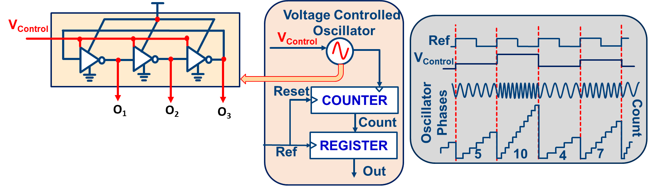
Single-Phase VCO-Based ADC
The architecture and conversion principle of a single-phase VCO-based ADC—a core building block for ultra-low power sensor interfaces, time-domain mixed-signal conversion, and emerging event-driven signal processing ICs.

Slide 22
Working of Single-Phase VCO-Based ADC
Core Structure:
The ADC is composed of a voltage-controlled ring oscillator, a digital counter, and a sample register. The analog input voltage (V_{control}) directly tunes the oscillator's frequency by modulating the delay of inverter stages.
Frequency Modulation and Counting:
When V_{control} increases, the oscillator's frequency rises, producing more transitions (edges) per unit time. Each inverter’s output (O₁,O₂,O₃...) forms a phase in the oscillator’s cycle.
Digital Conversion through Edge Counting:
The output edges from one oscillator phase are counted over a defined sampling period by the counter block. At the conclusion of each sampling period (marked by a reference clock event), the register latches the current count value, which is then provided as the ADC output.
Period Reset and Repeat:
After sampling, the counter is reset for the next interval, and the process is repeated to generate the ongoing digital output stream. The resulting digital code is directly correlated to the analog input, as higher input voltages yield higher counts per cycle.

Slide 23
Feature | VCO-Based ADC | Classic ADC (SAR/Pipeline)
Power Efficiency | Ultra-low | Moderate to high
Area | Minimal, no capacitive arrays | Larger, especially with passive elements
Analog Complexity | Very low, all digital core | Substantial
Supply Sensitivity | Needs calibration (oscillator sensitivity) | Stable, but more analog circuitry
Linearity | Moderate, nonlinearity from VCO | High, with architectural corrections
Speed | High (for moderate resolution) | Variable: SAR slow, Pipeline fast
Advanced Insights
Conversion Principle:
  This time-domain architecture translates amplitude information into frequency and then into an event count—a form of time-to-digital conversion.
Resolution Limitation:
  The precision of the ADC is limited by both the oscillator’s frequency range and the number of edges resolved within the reference period, making it less suitable for high-resolution signal acquisition but compelling for extreme low-power applications.
Robustness and Integration:
  VCO-ADCs offer simplification of analog front-ends, direct CMOS compatibility, and strong resilience to supply and process variations.

Slide 24
Single-Phase VCO-Based ADC
The sampled count is proportional to the oscillation frequency of the VCO, and therefore the input signal level (Resolution is lesser)
The Analog input signal modulates the VCO frequency via the tuning node, while the counter accumulates the number of transitioning edges during the sample period.
At the end of each period, the resulting count is sampled by a register with the counter reset to zero, and the process is repeated.

Slide 25

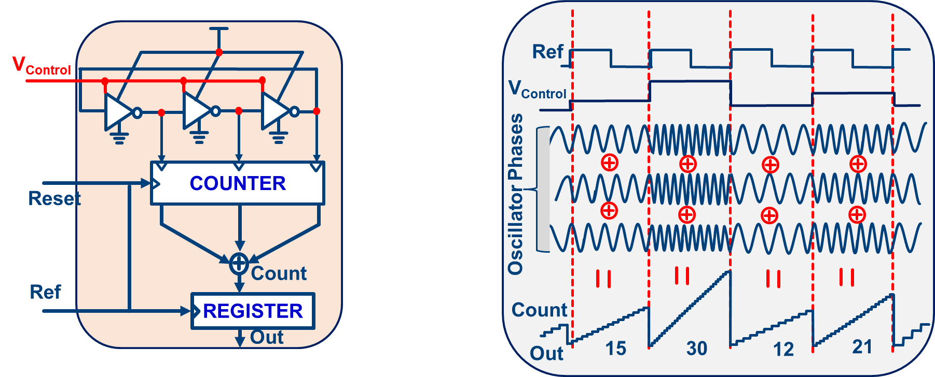

Multi-Phase VCO Based ADC
The core architecture and time-domain working principle of a multi-phase VCO-based ADC, a cutting-edge structure enabling enhanced resolution, linearity, and speed for time-domain analog-to-digital conversion in advanced mixed-signal ICs.

Slide 26

Multi-Phase Oscillator:
The analog input voltage (V_{control}) modulates the frequency of a ring oscillator, which produces several evenly spaced output phases. Each inverter in the ring contributes a separate phase, increasing the number of transition events available per reference clock period.
Parallel Edge Counting:
Each oscillator phase feeds the counter, rapidly accumulating multiple transitions per sample period. Rather than rely on a single edge stream, all phase outputs are summed—boosting frequency sensitivity and linearity.
Sample Acquisition:
At the end of each reference clock period, the aggregated count (sum of edges across all phases) is latched in a register, producing a proportional digital output for each sample window. The counter is reset and the sequence repeats continuously.
Resolution and Linearity Enhancement:
By exploiting multiple phase crossings, the architecture greatly increases the event rate and mitigates quantization and nonlinearity errors native to single-phase designs. This yields higher SNR and extends dynamic range.

Slide 27
Comparative Pros and Cons
Feature | Multi-Phase VCO-ADC | Single-Phase VCO-ADC
Resolution | Much higher due to multi-phase counting | Limited by single cycle/event stream
Linearity | Strong: mitigates dead-zone errors | Weaker; requires more calibration
Power/Area | Excellent; all digital; scalable | Slightly better, fewer outputs
Integration | Perfect for digital-centric ICs | Similarly ideal
Design Complexity | Moderate: requires multi-phase counting | Very low
Key Insights
Oscillator Phase Interleaving:Increases output code granularity and improves the mapping between analog input and digital count, making conversion less vulnerable to dead-zone nonlinearity and calibration limits.
Digital-Friendly Architecture:All phases, edges, and logic are natively compatible with standard digital cell libraries; area and power are minimized for moderate ENOB applications with robust PVT resilience.
Industry Impact:Multi-phase VCO-ADCs are leveraged in high-speed sensor interfaces, neural arrays, and ultra-low power wireless chips, thanks to their digital simplicity and scalable resolution.
Key Takeaway
Each phase crossing is counted, multiplying effective sensitivity and SNR.
Multi-phase VCO sampling tackles major sources of nonlinearity and quantization artifact.
Combinatorial edge counting improves monotonicity and reduces missing codes.
The approach is robust to digital process scaling, PVT environments, and supply voltage variation.

Slide 28
Multi-Phase VCO Based ADC
The sampled count is proportional to the oscillation frequency of the VCO, which in turn is proportional to the input signal level
Input: Analog tuning of the ring oscillator frequency.
Output: Count of oscillator cycles per Ref clock period.
Alon, Stojanovic, Horowitz JSSC 2005
Kim, Cho, ISCAS 2006

Slide 29
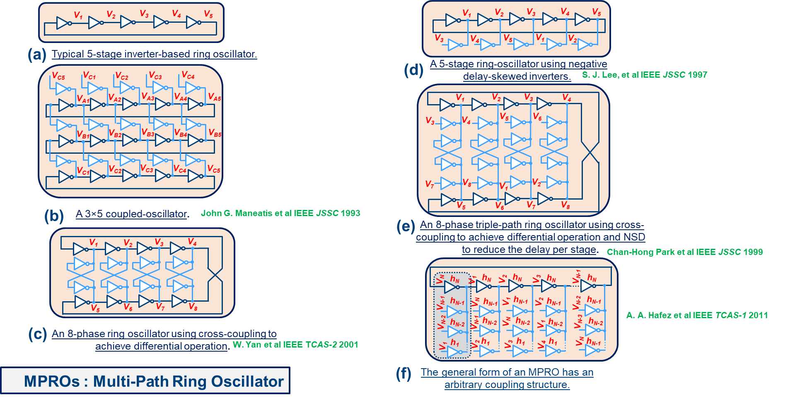
Different Architectures of MPROs
The progression of MPRO architectures—the foundation for highly tunable and robust clock, LO, and data recovery circuits in modern SoCs and transceiver ICs. Each structure achieves enhanced phase resolution, noise shaping, and delay control through circuit and coupling innovations on the inverter loop.

Slide 30
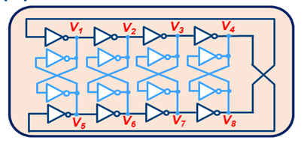
Classic Inverter-Based Ring Oscillator (5-stage)
Design: Simple serial string of five inverters, each stage contributing a progressive phase shift; the signal loops around to sustain oscillation.
Sizing: Optimal inverter sizing (W/L ratios) sets oscillation frequency, balancing power and phase noise. Symmetric p/n sizing typical for low jitter.
Ease of Design: Layout is trivial, ideal for rapid prototyping, student silicon, and moderate-precision low-area clocking.
Constraint: Limited phase output; only one output per inverter.
8-Phase Ring Oscillator w/ Differential Cross-Coupling (Yan et al. TCAS-2 2001)
Design: Eight inverters arranged with differential signals and cross-coupling to boost output granularity and noise resilience.
Sizing: Careful differential pair sizing, symmetric coupling for phase noise suppression, phase monotonicity, and optimal startup.
Ease of Design: Complex; differential coupling and matching are critical. Precision layout and verification required.
Constraint: Increased sensitivity to mismatch and silicon parasitics.
3×5 Coupled-Oscillator
(Maneatis et al. JSSC 1993)
Design: Three parallel chains of five inverters; outputs and control nodes distributed for increased phase density and mutual coupling.
Sizing: Coupling strength and inverter sizing determine both fundamental frequency and cross-chain phase alignment. Achieves improved phase noise via collective synchronization.
Ease of Design: Moderate. Multi-chain layout complicates routing, but digital synthesis tools can modularize the process.
Constraint: Must tune cross-coupling and ensure robust startup conditions

Slide 31

Negative Delay Skewed 5-Stage Ring Oscillator (Lee et al. JSSC 1997)
Design: Classic inverter ring with tailored inverter delay profiles—negative skew—increases frequency and improves phase spacing.
Sizing: Individual inverter-sizing and loading needed to create negative delay regions; timing simulation essential.
Ease of Design: More difficult; skew management and non-monotonic delay require sophisticated simulation and layout.
Constraint: Harder to calibrate; best for application-specific or research prototypes
Triple-Path 8-Phase Ring Oscillator w/ Cross-Coupling (Park et al. JSSC 1999)
Design: Integrates three interleaved oscillator paths, cross-coupled to reduce net delay and enhance phase accuracy; supports differential operation.
Sizing: Coupling path transistor sizing critical: sets phase response, startup reliability, and noise shaping characteristics.
Ease of Design: Similar to (c), requires careful cross-coupling, robust layout, and post-layout extraction validation.
Constraint: Highly sensitive to process corners and layout-induced parasitics.
Generalized Arbitrary-Coupling MPRO (Hafez et al. TCAS-1 2011)
Design: Fully reconfigurable multi-path topology allows arbitrary coupling and inverter arrangements—custom fit for application-specific delay and phase profiles.
Sizing: Designer can assign all inverter, coupling, and feedback sizes for custom frequency, phase, and startup behavior.
Ease of Design: Most challenging; requires system-level optimization, EM/circuit co-simulation, and iterative silicon validation.
Constraint: Maximum flexibility, minimum design simplicity; reserved for expert-level or innovation-driven deployments.

Slide 32
Sizing Constraints and Design Considerations
Startup Reliability: Sufficient feedback and initial signal must overcome process mismatch and loading; inverter sizes and coupling transistor strengths are crucial.
Phase Noise and Jitter: Sizing influences phase noise (jitter), supply sensitivity, and temperature stability; optimal sizing finds trade-off between low power and signal purity.
Layout Parasitics: Multi-path and cross-coupled designs can magnify the effect of layout-induced parasitics; post-layout extraction is mandatory for mission-critical or low-jitter designs.
Ease of Design vs. Performance: Simpler architectures (a, b) are ideal for rapid prototyping and digital-centric applications; advanced topologies (c–f) serve specialized, high-performance analog and RF nodes.
Key Takeaway
MPRO topologies allow granular control over output phase count, noise shaping, and delay.
Coupling and multi-path configurations are main levers for jitter reduction and phase fidelity.
Sizing directly sets oscillation frequency, output monotonicity, and ensure startup robustness.
Tradeoff: Simpler rings for area/power; multi-path/coupled designs for phase purity and flexibility

Slide 33
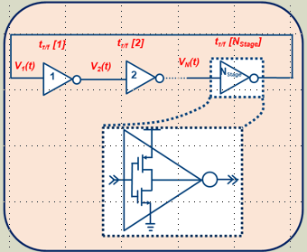
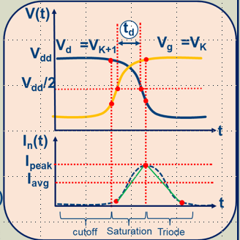
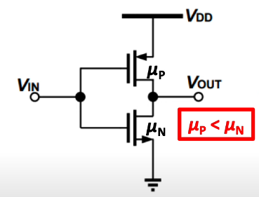
Transition Mechanisms of Single ended ROs
The core principles by which single-ended ring oscillators (ROs) generate clock and phase signals, emphasizing the interaction between stage count, inverter transition dynamics, and frequency scaling—a vital understanding for precision clocking in mixed-signal circuits.

Slide 34

(a) Stage Cascading and Delay Accumulation
Each inverter stage introduces a propagation delay (tpr), with the signal transitioning sequentially through the chain.
The oscillation period is set by the total accumulated delay across all stages:
  For an N-stage ring, total delay = N×t_{inv}
Increasing the number of stages grows the number of output phases but also stretches the period, thus lowering the oscillation frequency.
(b) Inverter Transition and Current Dynamics
Shows cross-section of an inverter during a bit transition and the associated current pulse (In(t)).
Transition timing and the current's peak and average value are influenced by device sizing (W/L), capacitance loading, and mobility.
The propagation delay is controlled by both the input ramp and output charging/discharging, with typical regions spanning cutoff, saturation, and triode regimes.

Slide 35
Transition and Phase Generation Insights
Increasing Stages—Advantage:
  Yields more evenly spaced phases, useful for multiphase clocking and waveform synthesis.
  Applied for odd number of stages: Ensures oscillation (loop gain >1) and stable phase formation.
Increasing Stages—Drawback:
  Cumulative delay grows, resulting in lower oscillation frequency.
Multi-Phase Generation for Even Stages:
  Requires special connection schemes (cross-coupling, feedback networks) for robust phase/frequency targets.
Sizing and Design Considerations
Inverter Size:
  Sets drive strength, transition speed, and power consumption. Tradeoff: Larger size → faster transition, higher power/jitter.
Load Capacitance:
  Directly determines transition delay: lower capacitance accelerates oscillation, but may reduce drive margins.
Stage Count:
  Dictates both available phase outputs and maximum clock rate: odd stages standard, even-stage needs advanced topology.
Startup Robustness:
  Sufficient gain, matched delays, and symmetric signal paths prevent deadlocks and missing oscillation.

Slide 36
Transition Mechanisms of Single ended ROs
_{Osc.}
_{Freq}
_{Number Of stages}
_{Osc.}
_{Freq}
t
Increasing Stages = Equivalent Multi-phases= Applied for odd stages
_{# of Phases}
= Accumulate effective delay = Less Oscillation Frequency
Specific connections are required for even multi-phase generation

Slide 37
Research Problem 1
Key Highlights
General Method to generate multi-Phase which consumes lesser power and lower phase noise with less prone to PVT Variation
Key Outcomes
Neeraj Mishra, L. M. Dani, K. Sanvaniya, S. Dasgupta, S. Chakraborty and A. Bulusu, "Design and Realization of High-Speed Low-Noise Multi-Loop Skew-Based ROs Optimized for Even/Odd Multi-Phase Signals," in IEEE Transactions on Circuits and Systems II: Express Briefs, vol. 67, no. 11, pp. 2352-2356, Nov. 2020.

Slide 38
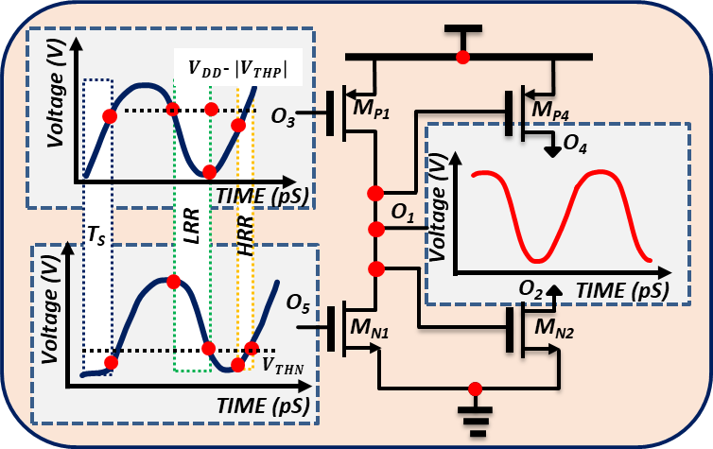
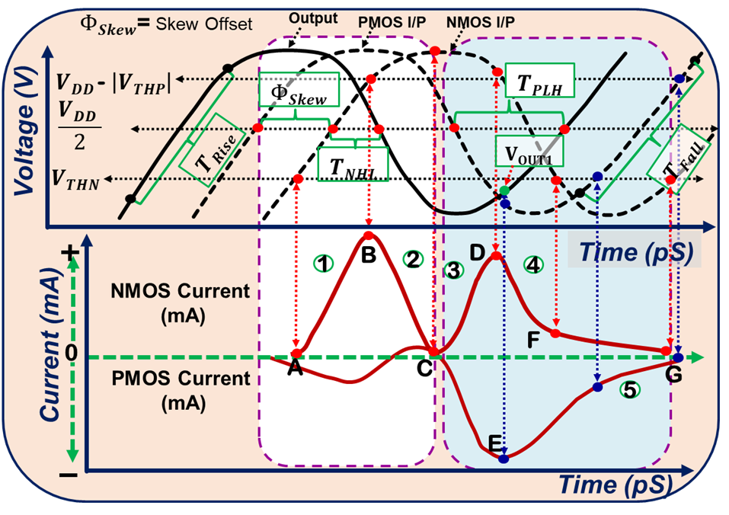

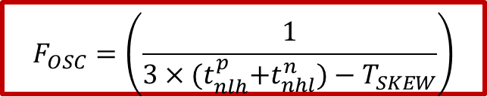
Negative Skew-Offset Delay Cell
The negative-skew offset single delay cell of 5 stages MSSROs
It was found that skew offset is always responsible for the optimization of the output transition during the analysis of separately driven delay cells/Ring Oscillators.
The output falling transition is favored by the input rising transition with a negative skew offset case (3N-1).
This is due to the NMOS/PMOS device being in the ON/active state, and NMOS is responsible for discharging the (C_{L}+C_{P}).
$$F_{OSC}=\left(\frac{1}{3×{(t}_{nlh}^{p}+t_{nhl}^{n})−T_{SKEW}}\right)$$
When the input falling transition with NSO appears at the gate of PMOS and NMOS, both devices are switched on due to skew offset between them during transition compared to conventional three-stage conventional ROs (CROs).

Slide 39
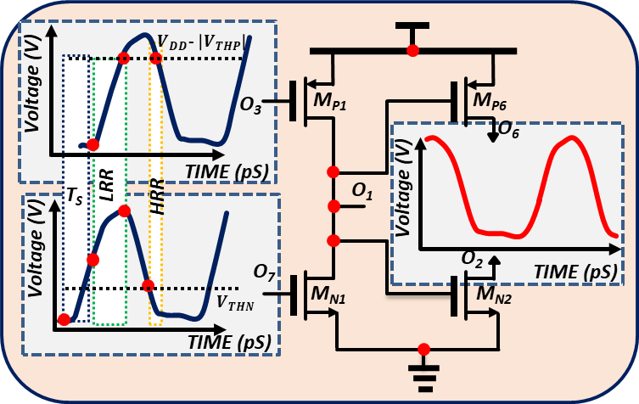
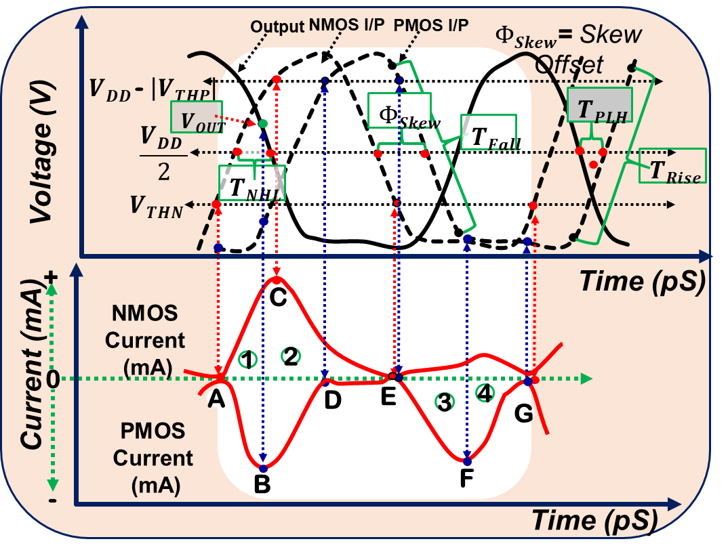
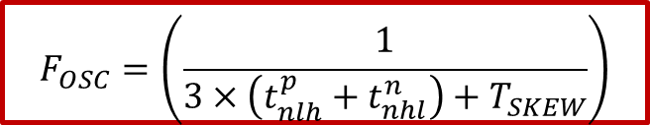
Positive Skew-Offset Delay Cell
The positive-skew offset single delay cell of 7 stages MSSROs
High Resistance Transitions Region (HRTR): In this region, both transistors (PMOS and NMOS) are either weakly ON or in an entirely OFF state (Floating node).
Low Resistance Transition Region (LRTR): Both the transistors are ON (or short-circuit) in this region.
$$F_{OSC}=\left(\frac{1}{3×\left(t_{nlh}^{p}+t_{nhl}^{n}\right)+T_{SKEW}}\right)$$
When the input rising transition with PSO appears at the gate of NMOS and PMOS, both devices are switched on due to skew offset between them during transition compared to conventional three-stage conventional ROs (CROs).

Slide 40


Concept of Skew in Delay Cells
N Mishra et al. IEEE TCAS-II 2019
Negative Skew
1
2
3
PMOS I/P
1
2
3
4
±t_{skew}
M_{P}
I_{N}
I_{P}
I_{Z}
(a)
(b)
(c)
t_{nhl}
V_{DD}/2
t_{nlh}
NMOS I/P
V_{DD}/2
R
R
R
M_{N}
Output Transition due to
(a) Negative,(b) Positive, and (c) Zero Skew Offset
t_{dl}
Negative Skew Offset
Positive Skew offset
Zero Skew offset
Output
t_{dh}
A negative/positive/zero skew offset between the inputs of the delay cell.
t_{phl}
t_{plh}
Timing diagram of negative skew offset delay cell
Case 1. Negative-Skew offset (NSO): M_{P} (I_{N}) is faster (comes before) than that of M_{N} (R). Possible stages (3N-1) where N ≥ 2
Case 2. Positive-Skew offset (PSO): M_{P} (I_{P}) is slower (comes after) than that of M_{N} (R). Possible stages (3N+1) where N ≥ 1
Case 3. Zero-Skew offset (ZSO): M_{P} (I_{Z}) overlaps with that of M_{N} (R). Possible stages (3N) where N ≥ 2
Region | Operation of NMOS | Operation of PMOS
1 | Cutoff | Saturation
2 | Cutoff | Cutoff
3 | Sat/Linear | Cutoff
4 | Linear | Linear/Sat

Slide 41
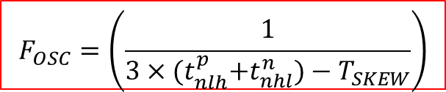

MSSROs Operation in ZSO & NSO
1
2
3
4
5
6
1
2
3
4
5
P1
V_{NSO}
P1
Voltage
2
3
M_{P3}
M_{P4}
1
4
M_{P5}
M_{P1}
M_{P2}
M_{P5}
M_{P6}
X
M_{P1}
M_{P2}
M_{P3}
M_{P4}
Time
A
T_{SKEW}
A
P3
P2
P3
P2
V_{N}
Voltage
M_{N1}
M_{N2}
M_{N3}
M_{N4}
M_{N5}
M_{N6}
M_{N1}
M_{N2}
M_{N3}
M_{N4}
M_{N5}
F_{OSC}
T₄
Time
T₃
T₂
P4
F_{OSC}
(a)
T₁
NSO
P4
(c)
Possible stages (3N) where N ≥ 2
Possible stages (3N-1) where N ≥ 2
Overlapped Phases
$$F_{OSC}=\left(\frac{1}{3×{(t}_{nlh}^{p}+t_{nhl}^{n})−T_{SKEW}}\right)$$
$$F_{OSC}^{3N−1}>F_{OSC}^{3−Stage−Conv}$$
(b)
(d)
(c)
Signal flow paths of 5 Stage (NSO) MSSROs
Its phases
Signal flow paths of 6 Stage (ZSO) MSSROs and
Its phases arrangements
(d)
(b)
41

Slide 42
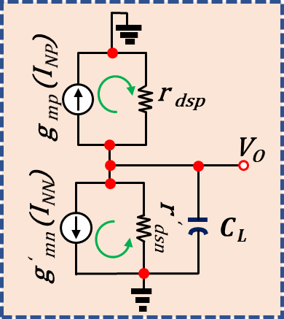
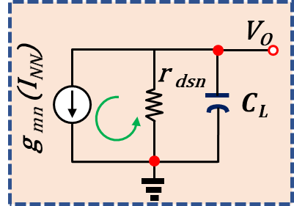



















In-depth analysis of 5 Stages MSSROs
1
2
3
4
5
P
HIGH
O₃
O₂
O₃
M_{P1}
M_{P2}
M_{P3}
M_{P4}
M_{P5}
$$MP1$$
$$MP4$$
$$MP5$$
$$MP2$$
O₅
$$MP3$$
a₁
O₁
O₄
$$MP1$$
O₁
O₁
O₄
O₂
O₃
$$MN1$$
O₃
$$MN4$$
$$MN5$$
O₅
O₁
O₂
O₃
O₄
O₅
$$MN1$$
$$MN2$$
$$MN3$$
M_{N5}
M_{N4}
M_{N3}
M_{N4}
M_{N5}
O₅
P
LOW
_{c}
_{d}
a₂
a
_{b}
τ
$$MP1$$
τ
$$MP2$$
τ
$$MP3$$
O₁
O₄
O₃
O₂
O₅
τ
$$MP1$$
τ
$$MP2$$
τ
$$MP3$$
O₁
O₂
O₃
O₁
O₂
O₃
$$MN1$$
$$MN2$$
$$MN3$$
$$MN1$$
$$MN2$$
_{e}
$$MN3$$
2
_{e}
(a) Equivalent small-signal diagram for the separately skew-based delay cell in the (a₁) output rise, (a₂) output fall transitions, (b) A 5-stage NSO-based MSSRO architecture with the oscillation paths marked red and green, effective oscillating structure for the (c) NMOS (M_{N5}) and the (d) PMOS (M_{P1}) in the delay cell, (e) the 2 loosely coupled 3-stage skew-based MSSRO.

Slide 43
Frequency and phase noise of MSSROs
1
2
(a)
(b)
Simulation results of (a) 180nm for V_{DD}=1.8 (b) 65nm for V_{DD}=1.2.
The Oscillation frequency is almost independent with an increasing number of stages
The phase noise reduces while the frequency sustains its value with an increasing number of stages

Slide 44
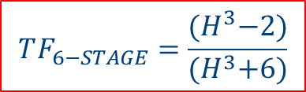
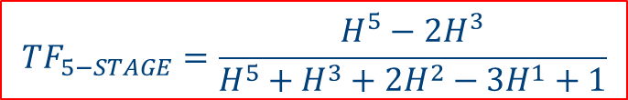
Phase noise MSSRO
-1
-1
-1
-1
-1
-1
-1
H
B
H
C
H
D
H
E
H
F
H
1
H
2
H
3
H
4
H
5
H
6
A
1
2
3
4
5
A
B
C
D
E
F
G
-1
-1
-1
-1
-1
-1
(a)
(b)
Signal flow diagram of (a)5 stage (NSO), and (b) 6 stage (ZSO) MSSRO
$$TF_{5−STAGE}=\frac{H^{5}−2H^{3}}{H^{5}+H^{3}+2H^{2}−3H^{1}+1}$$
$$TF_{6−STAGE}=\frac{{(H}^{3}−2)}{{(H}^{3}+6)}$$
As we increase the number of stages in MSSRO, the number of loops increases, reducing the overall small signals gain and, therefore, improving the phase noise.
The small signal noise is amplified less as the denominator is larger compared to the nominator.

Slide 45




Noise Mechanism in MSSROs
N Mishra et al. IEEE TCAS-I
Output
I/P
Output
PMOS I/P
NMOS I/P
$VDD$ - $\left|VTHP\right|$
$VDD$ - $\left|VTHP\right|$
Voltage (V)
$$\frac{VDD }{2}$$
Voltage (V)
$$\frac{VDD }{2}$$
Note that the NMOS and PMOS contribute noise to the output during the output LH transition in the MSSRO, unlike in the conventional case.
$$VTHN$$
$$VTHN$$
R₁
R₂
R₃
R₄
R₁
R₂
R₃
R₄
Positive Current
(mA)
B
Time (ps)
Positive Current
(mA)
B
E
Time (ps)
NMOS Current (mA)
NMOS Current (mA)
Current (mA)
Current (mA)
F
Negative Current
(mA)
A
C
E
Negative Current
(mA)
A
C
G
PMOS Current (mA)
PMOS Current (mA)
D
D
Time (ps)
Time (ps)
NMOS Contribution
NMOS Contribution
Flicker
Envelope
Flicker
Envelope
Time (ps)
PMOS Contribution
Time (ps)
PMOS Contribution
So it means that the MSSROs are having poor Phase Noise?
NMOS Contribution
Time (ps)
NMOS Contribution
Time (ps)
Thermal
Envelope
Thermal
Envelope
Time (ps)
PMOS Contribution
Time (ps)
PMOS Contribution
Time (ps)
Time (ps )
Thermal and flicker noise contributions conventional inverter-based RO (left) and the NSO-based MSSRO (right).

Slide 46

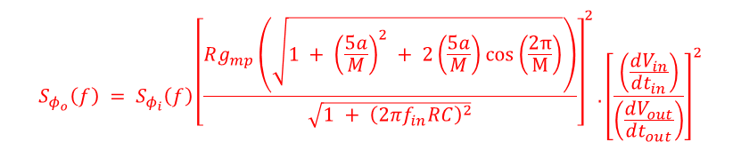
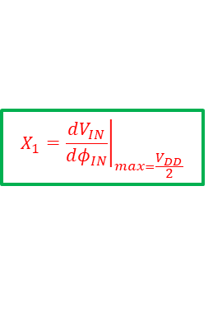




Phase & Noise Transfer Function Mechanism and its shaping function
$$X_{1}={\left.\frac{dV_{IN}}{dφ_{IN}}\right|}_{\max{=}\frac{V_{DD}}{2}}$$
$$X_{2}={\left.\frac{dV_{OUT}}{dV_{IN}}\right|}_{\max{=}\frac{V_{DD}}{2}}$$
$$X_{3}=\frac{dφ_{OUT}}{dV_{OUT}}= \frac{1}{\frac{dV_{OUT}}{dφ_{OUT}}}$$
$$G_{φ}=X_{1}×X_{2}×X_{3}$$
$$S_{φ_{o}}\left(f\right) = S_{φ_{i}}\left(f\right){\left|G_{φ}\left(f_{in}+f\right)\right|}^{2}$$
$$S_{φ_{o}}\left(f\right) = S_{φ_{i}}\left(f\right){\left[\frac{Rg_{mp}\left(\sqrt{1 + {\left(\frac{5a}{M}\right)}^{2} + 2\left(\frac{5a}{M}\right)cos\left(\frac{2π}{M}\right)}\right)}{\sqrt{1 + {\left(2πf_{in}RC\right)}^{2}}}\right]}^{2}.{\left[\frac{\left(\frac{dV_{in}}{dt_{in}}\right)}{\left(\frac{dV_{out}}{dt_{out}}\right)}\right]}^{2}$$
Phase transfer process from the input to the output of a skew-based inverter delay cell

Slide 47
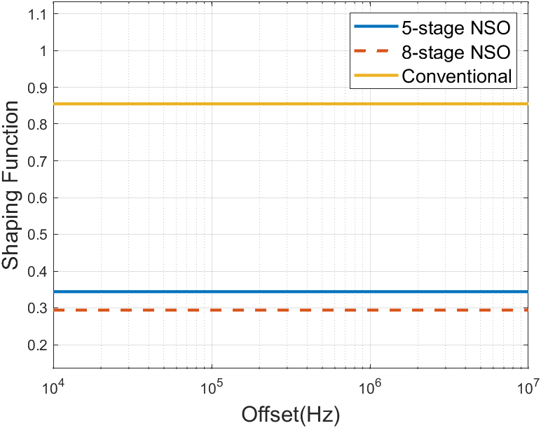
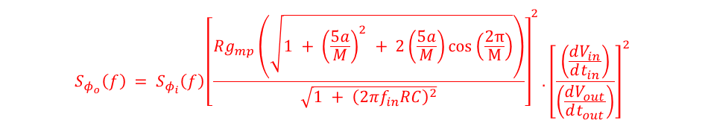
The magnitude of shaping mechanism in different stages ROs
$$S_{φ_{o}}\left(f\right) = S_{φ_{i}}\left(f\right){\left[\frac{Rg_{mp}\left(\sqrt{1 + {\left(\frac{5a}{M}\right)}^{2} + 2\left(\frac{5a}{M}\right)cos\left(\frac{2π}{M}\right)}\right)}{\sqrt{1 + {\left(2πf_{in}RC\right)}^{2}}}\right]}^{2}.{\left[\frac{\left(\frac{dV_{in}}{dt_{in}}\right)}{\left(\frac{dV_{out}}{dt_{out}}\right)}\right]}^{2}$$
Output
PSD
Input
PSD
Gain of the stage with skew offset
Slope Factor of skew-based design
Shaping Function of skew-based design
Comparison of shaping function magnitude of the 5 and 8 stages NSO ROs with the conventional 3 stages RO; it is found that higher the skew offset higher its magnitude and lower the suppression and vice versa

Slide 48
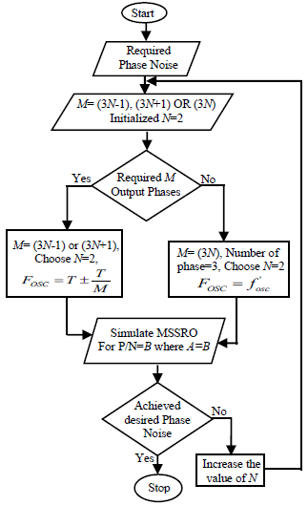




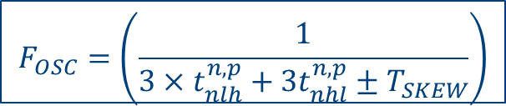
Algorithm for desired Phase Noise in MSSROs
(1) The (P/N) = A ratio of a three-stage SCRO is selected to achieve the required duty cycle and its time period (T) is measured.
(2) This value of T is now utilized for the calculation of skew offset (T_{skew}) of the desired number of stages (M) of MSSRO.
(3) Using this T_{skew}, we further calculate the oscillation frequency.
(4) If the phase noise target is met, the design is freezed. If the target is not met, repeat Step 2 with an increased M.
$$T_{SKEW}=\frac{\left(Period\right)}{M}$$
$$F_{OSC}=\left(\frac{1}{3×t_{nlh}^{n,p}+3t_{nhl}^{n,p}±T_{SKEW}}\right)$$
$t_{dh}^{n,p}=2×t_{nhl}^{n,p}+t_{plh}^{n,p}$
$$F_{OSC}=Period±\frac{Period}{M}$$
$$t_{dl}^{n,p}=t_{nhl}^{n,p}+2t_{plh}^{n,p}$$
The +/- sign is valid for positive skew (M=3N+1)/ negative skew (M=3N-1) cases, whereas, for the no skew (M=3N) case, the oscillation frequency is equal to that of conventional RO
Design of N stages MSSRO.

Slide 49

MSSRO comparison with 3-stage Conventional RO
(a)
(b)
(c)
Comparison of the corner analysis in 180nm for V_{DD}=1.8
The supply sensitivity (% change in total frequency by ± 5% variation in V_{DD})
Power consumption is smaller for an MSSRO for given phase noise in the 180nm for V_{DD}=1.8
Design | PVT Variation | Supply Sensitivity | Power Consumption for Equivalent PN
3 Stages CRO | High | High | High
MSSROs | Less | Less | Less

Slide 50
Research Problem 2
Key Highlights
General Method to generate highest oscillation frequency in single ended Ring oscillators while keeping all benefits as in project 1
Key Outcomes
Neeraj Mishra, L. M. Dani, S.Chakraborty, R. V. Joshi and A. Bulusu, "Delay Modulation in Separately Driven Delay Cells Utilized for the Generation of High-Performance Multiphase Signals Using ROs," in IEEE Transactions on Circuits and Systems II: Express Briefs, vol. 69, no. 1, pp. 30-34, Jan. 2022, (Appeared in 50 Popular Articles).
50
50

Slide 51


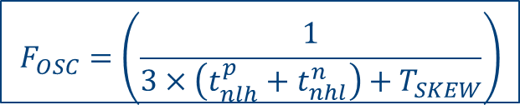
Positive Skew-Offset Delay Cell with loading
$VDD$ - $\left|VTHP\right|$
High Resistance Transitions Region (HRTR): In this region, both transistors (PMOS and NMOS) are either weakly ON or in an entirely OFF state (Floating node).
Low Resistance Transition Region (LRTR): Both the transistors are ON (or short-circuit) in this region.
Voltage (V)
M_{P1}
M_{P6}
O₃
O₆
LRR
TIME (pS)
Voltage (V)
T_{S}
HRR
O₁
Voltage (V)
O₂
O₇
TIME (pS)
$$VTHN$$
M_{N1}
M_{N2}
TIME (pS)
$$F_{OSC}=\left(\frac{1}{3×\left(t_{nlh}^{p}+t_{nhl}^{n}\right)+T_{SKEW}}\right)$$
The positive-skew offset single delay cell of 7 stages MSSROs
When the input rising transition with PSO appears at the gate of NMOS and PMOS, both devices are switched on due to skew offset between them during transition compared to conventional three-stage conventional ROs (CROs).

Slide 52


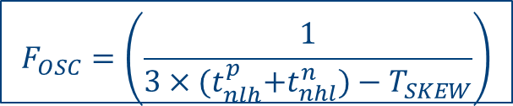
Negative Skew-Offset Delay Cell with Loading
It was found that skew offset is always responsible for the optimization of the output transition during the analysis of separately driven delay cells/Ring Oscillators.
The output falling transition is favoured by the input rising transition with a negative skew offset case (3N-1).
This is due to the NMOS/PMOS device being in the ON/active state, and NMOS is responsible for discharging the (C_{L}+C_{P}).
$VDD$ - $\left|VTHP\right|$
Voltage (V)
M_{P1}
M_{P4}
O₃
O₄
TIME (pS)
Voltage (V)
LRR
O₁
T_{S}
HRR
O₅
O₂
TIME (pS)
Voltage (V)
M_{N1}
M_{N2}
$$VTHN$$
TIME (pS)
The negative-skew offset single delay cell of 5 stages MSSROs
$$F_{OSC}=\left(\frac{1}{3×{(t}_{nlh}^{p}+t_{nhl}^{n})−T_{SKEW}}\right)$$
When the input falling transition with NSO appears at the gate of PMOS and NMOS, both devices are switched on due to skew offset between them during transition compared to conventional three-stage conventional ROs (CROs).

Slide 53

The impact of sizing variation in MSSROs
N Mishra et al. IEEE TCAS-II 2022
(a)
(b)
The impact of variation of NMOS sizing (width W) and PMOS size fixed at W = 10 µm (180nm) for (a) NSO (b) PSO.
As we vary the device sizes ratio of NMOS/PMOS while keeping other devices’ sizes constant, there is no improvement in the skew-offset/propagation delay of the MSSRO.
cv
cv
So, changing the device size will not efficiently increase the oscillation frequency
cv
Thus, there is a need for some mechanism for modulation of delay at the stage level.

Slide 54
Delay Modulation in Separately Driven Delay Cell (SDDC)
V_{NSO}
V_{PSO}
V_{PSO}
T_{P1} >T_{P2}
1
2
3
4
Voltage
2
3
V_{NSO}
Voltage
V_{O_NSO}
Voltage
3
V_{NSO}
V_{NSO}
/V_{PSO}
1
4
t_{skew}
M_{P}
T_{P1}
2
4
t_{skew}
M_{P}
M_{PC}
T_{P2}
Voltage
M_{P}
M_{PC}
X
Low-resistance
Voltage
V_{O_PC_PSO}
t_{skew}
T_{P2}
1
HRR
Time
High-resistance
Time
Voltage
V_{O_PDC_NSO}
Time
Voltage
V_{O_PD_NSO}
Time
A
V_{PSO}
Pre-Discharge
Path
T_{SKEW}
Pre-
Charge Path
Output
Voltage
LRR
A
Time
Time
Output
Time
T_{SKEW}
I_{PRE_C}
I_{CHA}
T_{P1}
I_{DIS}
Output
Time
I_{PRE_D}
Voltage
X
Voltage
V_{O_PSO}
V_{N}
V_{N}
V_{N}
C_{L}+C_{Par}
Voltage
V_{O_PDC_PSO}
Voltage
V_{N}
C_{L}+C_{Par}
M_{N}
V_{N}
Voltage
M_{N}
M_{PD}
V_{N}
Time
M_{N}
M_{PD}
T₁
T₄
Pre-
Charge Path
T₂
a₂
T₃
Time
Proposed
PC-PSO
T₄
Time
b₁
b₂
B
1
2
3
4
Time
T₃
T₂
T₁
Proposed
PD-NSO
PSO
Time
a₁
A
PSO
NSO
NSO
Pre-
Discharge Path
C
The concept of adding FF pre-discharging, pre-discharging path in (A) NSO (B) PSO (C) NSO-PSO
High Resistance Region (HRR): Both transistors are either weakly ON / OFF (Floating node A), and Their prolonged duration shifts (delayed) the output transition.
Low Resistance Region (LRR): Both transistors are ON (or short-circuit) in this case. Its prolonged duration slows down the output transition.

Slide 55
Quadrature Signal Generation
75%
Proposed 4-stage PCD-PSRO
Output transition of 4 stages (a) MSSRO and (b) PCD-PSRO
Using the above mechanism, the effective skew-offset, as well as propagation delay at the stage level, will effectively change, which results in :
Higher oscillation frequency for PSO & NSO (Possible to achieve the highest possible frequency).
The Transition speed-up result in less noise susceptibility.

Slide 56
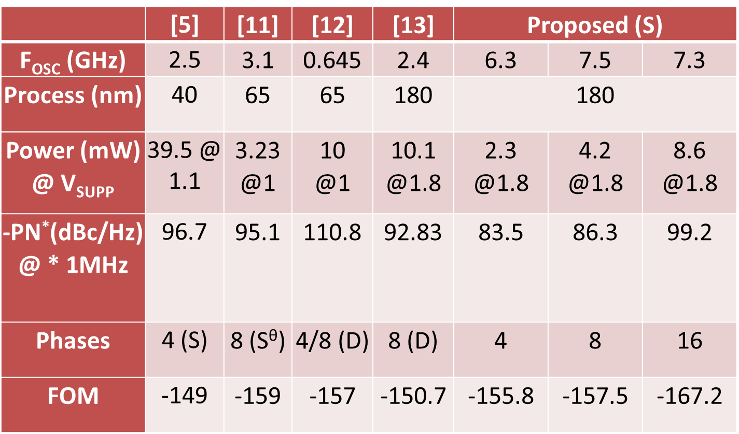
Comparison of the proposed design with MSSRO
(a)
(b)
(c)
(d)
Comparison of the proposed design w.r.t MSSRO’s (a) Temperature variation (b) Process corner analysis. FOM of different number of stages of MSSRO and proposed design (c) 180nm, (d) 65nm
[5] H.Yuan et al., al Electron. Lett., 2019
[11] I. Sun et al. IEEE TCAS-II 2019
[12] J. Kim et al., IEEE TCAS-II 2013
[13] X. Gui et al IEEE TCAS-1 2013

Slide 57
Research Problem 3
Key Highlights
Generalized Edge Propagation and Multi-Band Frequency Switching Mechanism for MSSROs” which is must required for its usability in real high performance sub-systems
Key Outcomes
Neeraj Mishra, Anchit Proch, Lomash Acharya, S. Chakraborty, and B. Anand, “Generalized Edge Propagation and Multi-Band Frequency Switching Mechanism for MSSROs” IEEE Transactions on Circuits and Systems II: Express Briefs vol. 70, no. 9, pp. 3609-3613, Sept. 2023 doi: 10.1109/TCSII.2023.3267384.
57
57

Slide 58

Bottlenecks of MSSROs for its usage in Sub-Systems
How to achieve lower frequencies with the MSSRO architecture,
while enjoying all other benefits it provides
(lower power dissipation, better phase noise, multiple phases)?
.
Change multi-loop length
Benefits:
High-frequency range (2-7 GHz) in 180nm Technology
Lesser multi-mode operation
Change relative NMOS-to-PMOS size ratios
Problem: The range of frequencies achieved is within range (0.5-0.6 GHz)
Attach load capacitances
Problem: Oscillator fails to sustain oscillation for a majority of sizes, if the load is large. So, a large frequency range is not practically achievable
Problem: Difficult to predict the frequency and phase sequence for a connection scheme.
Solution: we propose a generalized phase sequence and frequency prediction method to achieve frequencies equivalent to any (2n+1)-stage conventional RO with a pre-defined phase sequence
58

Slide 59
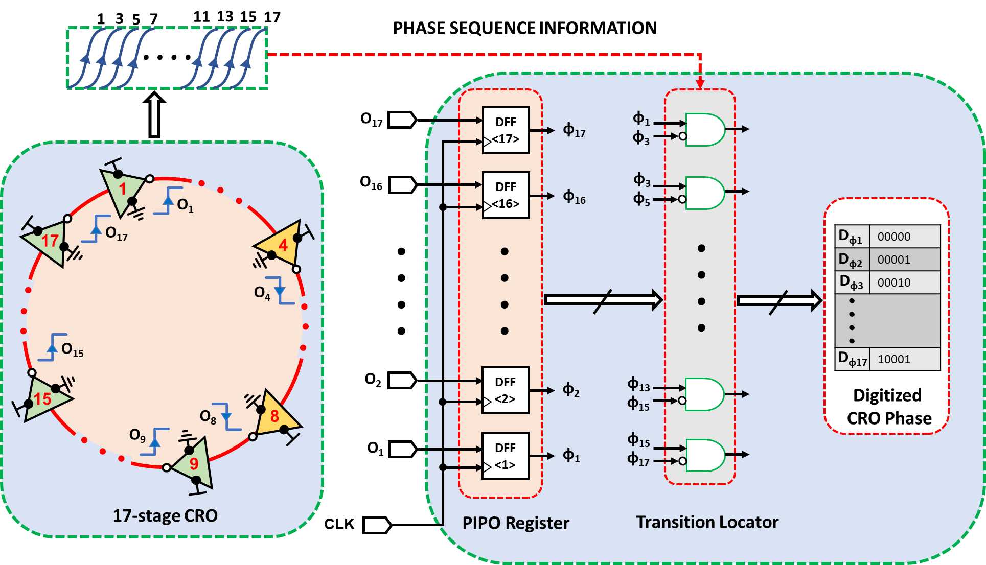
Standard Time to digital converters designs
In standard TDCs, the resolution is mainly dependent on the following:
Number of stages
Sampling methods,
But in principle, there is always a trade-off between the resolution and sampling method.
Thus design of sub-pico resolution is critical
As the number of stages increases, the resolution decreases.
Standard Time to Digital Converter using single ended 17 stages CRO

Slide 60
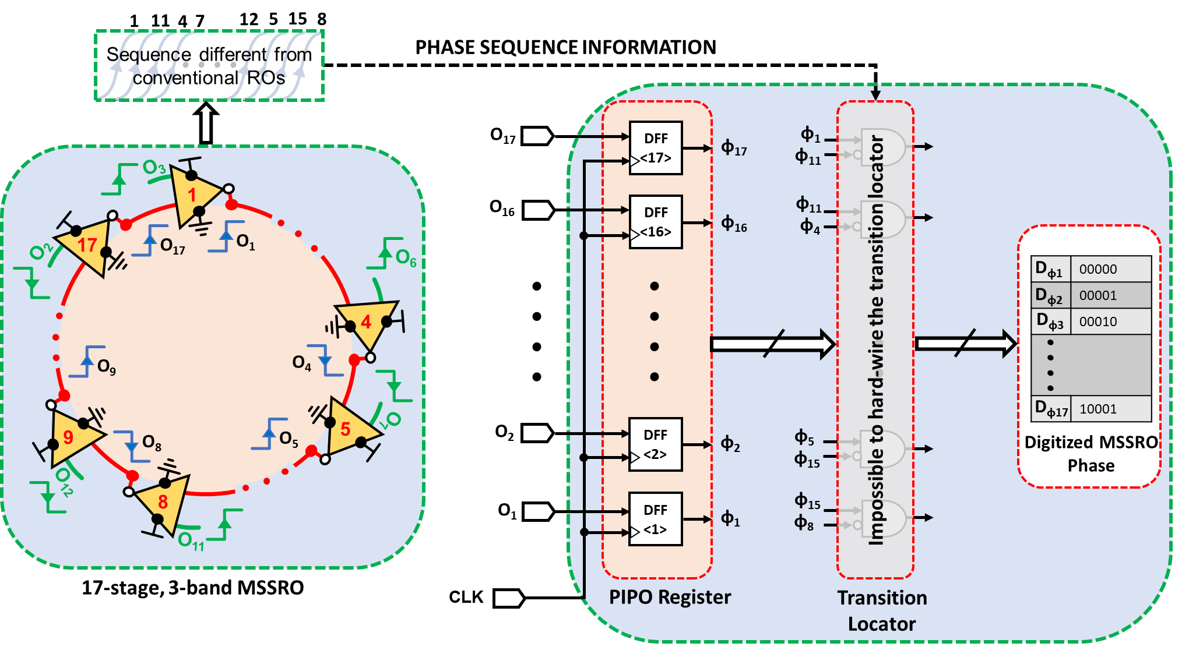
Requirements of MSSROs for design in Sub-Systems
Thus to increase the resolution, we used the MSSROs, but then we found:
Its edge propagation mechanism is different from the conventional ROs
There is a need for prediction of edge propagation mechanism)
The standard sampling circuits fail to capture propagation methods
There is a requirement for high-rate sampling circuits, or we may have some switching mechanism of frequency switching to different bands.
Time to Digital Converter using 17 stages MSSROs

Slide 61
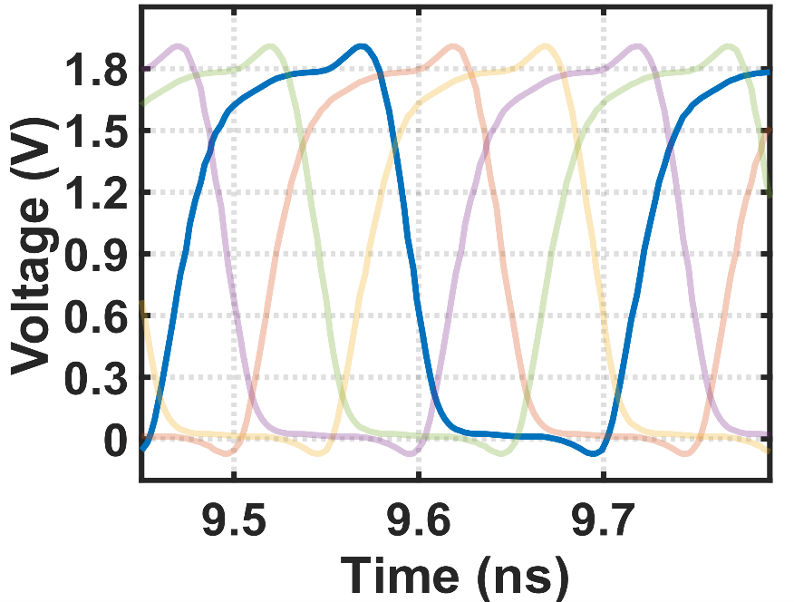
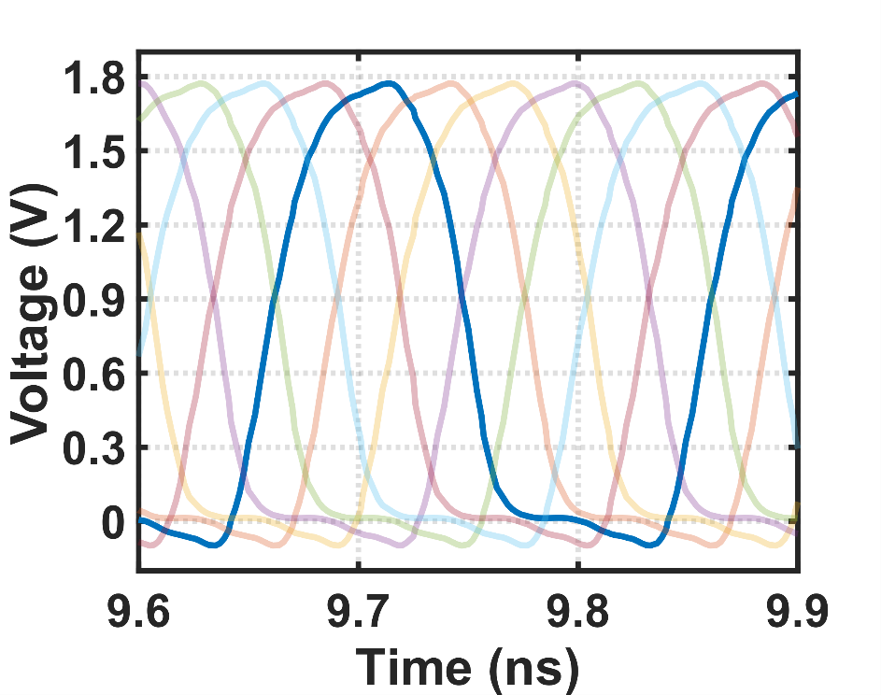
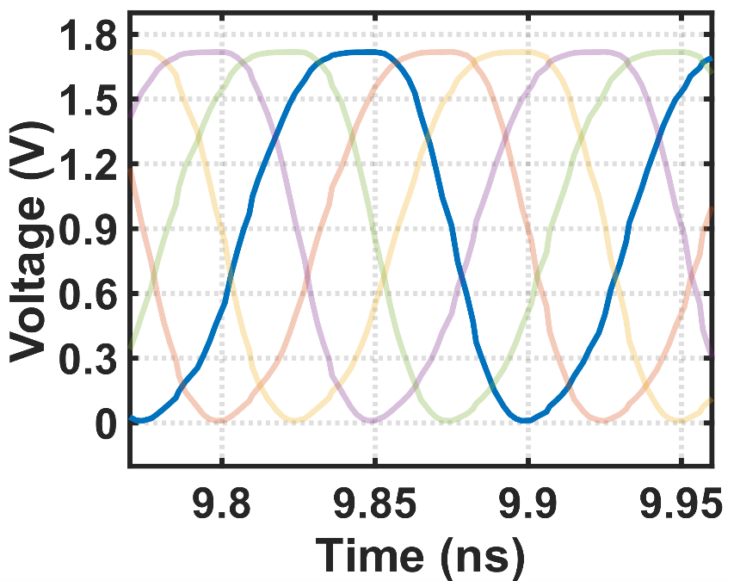
Edge Propagation in MSSROs
N Mishra et al. TCAS-II (2023)
1
3
5
7
2
4
6
1
7 stages CROs
1
3
5
2
4
1
ɸ₁
ɸ₂
ɸ₃
ɸ₄
ɸ₅
Period = 248.3 pS
(a)
1
4
7
3
6
2
5
1
Period = 201 pS
ɸ₁
ɸ₂
ɸ₃
ɸ₄
ɸ₅
ɸ₆
ɸ₇
1
3
5
2
4
1
ɸ₁
ɸ₂
ɸ₃
ɸ₄
ɸ₅
Period = 128.4 pS
(c)
Edge Propagation mechanism in (a) 5 stages CROs, (b) 5 and (c) 7 stages MSSROs with 3 stages loop.
(b)

Slide 62
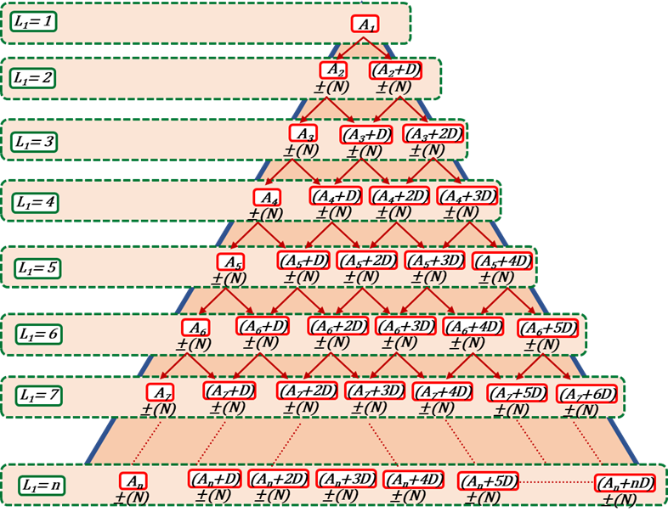
Edge Propagation mechanism in MSSROs
1
2
4
1
3
5
2
2
6
4
1
3
5
3
4
7
5
2
4
1
3
4
1
5
2
ɸ₃
ɸ₄
ɸ₅
ɸ₁
ɸ₂
5
2
6
3
7
6
3
7
4
1
5
(b)
7
4
1
5
2
6
3
ɸ₃
ɸ₂
ɸ₁
ɸ₇
ɸ₆
ɸ₅
ɸ₄
(a)
(c)
Phase trees for (a) the N-stage Multi Band MSSRO,( b) the 5-stage, 3-band MSSRO, and (c) the 7-stage, 3-band MSSRO

Slide 63
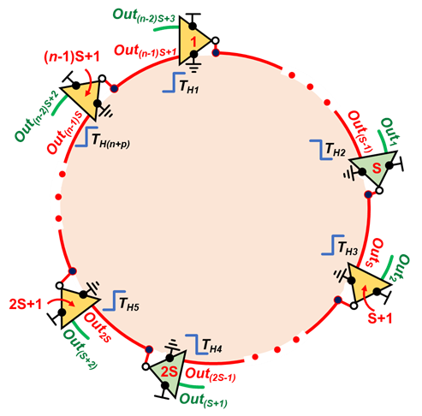
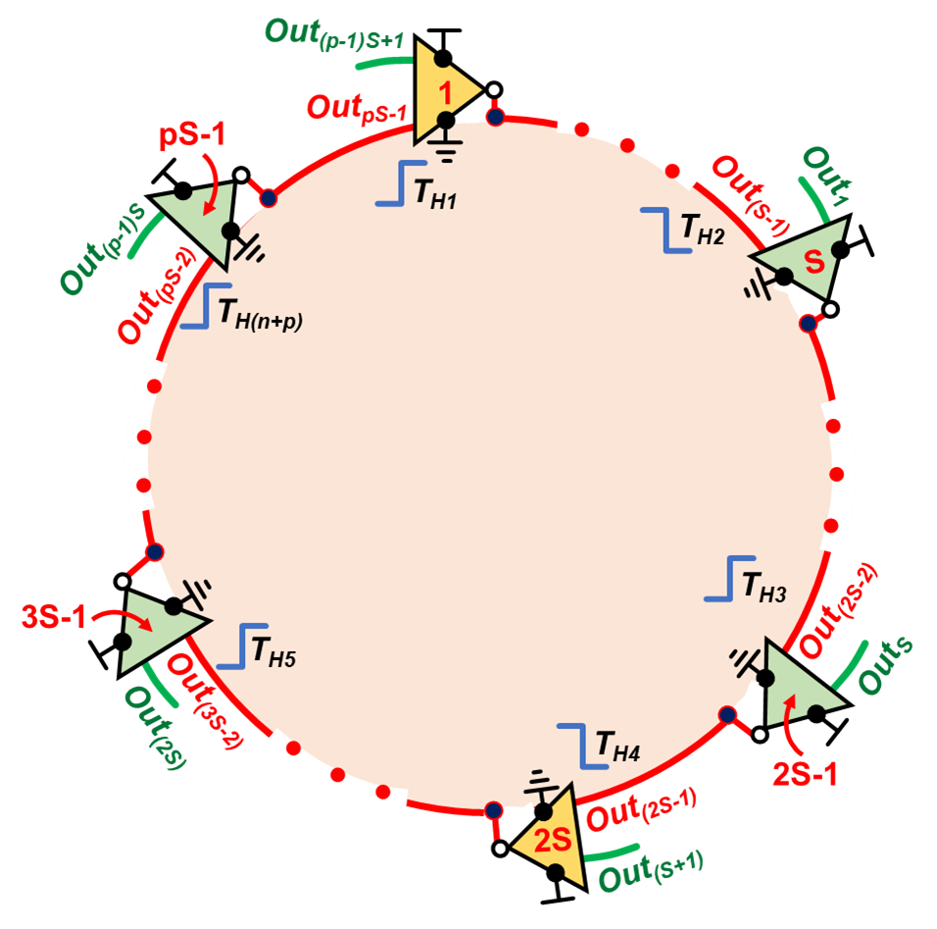
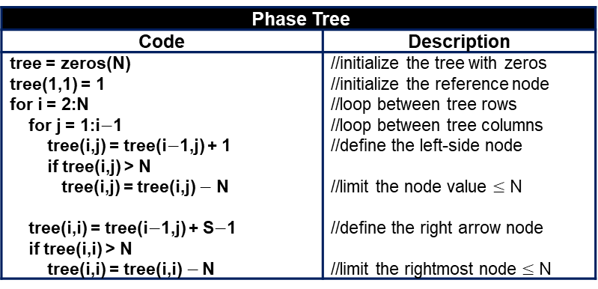
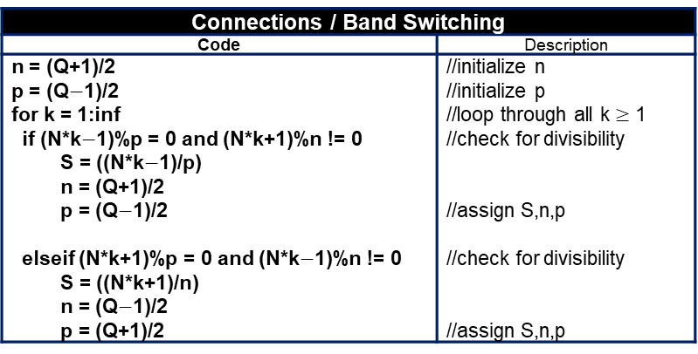
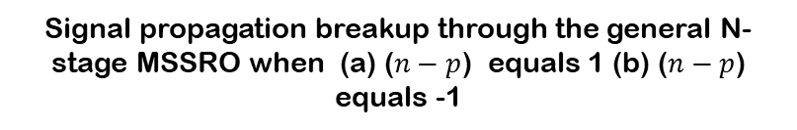
Band-Switching Mechanism and its general Algorithm
Signal propagation breakup through the general N-stage MSSRO when (a) ($n−p$) equals 1 (b) ($n−p$) equals -1
(a)
(b)
Connections / Band Switching
Code | Description
n = (Q+1)/2 p = (Q$−$1)/2 for k = 1:inf if (N*k$−$1)%p = 0 and (N*k+1)%n != 0 S = ((N*k$−$1)/p) n = (Q+1)/2 p = (Q$−$1)/2 elseif (N*k+1)%p = 0 and (N*k$−$1)%n != 0 S = ((N*k+1)/n) n = (Q$−$1)/2 p = (Q+1)/2 | //initialize n //initialize p //loop through all k $≥$ 1 //check for divisibility //assign S,n,p //check for divisibility //assign S,n,p
Phase Tree
Code | Description
tree = zeros(N) tree(1,1) = 1 for i = 2:N for j = 1:i$−$1 tree(i,j) = tree(i$−$1,j) + 1 if tree(i,j) > N tree(i,j) = tree(i,j) $−$ N tree(i,i) = tree(i$−$1,j) + S$−$1 if tree(i,i) > N tree(i,i) = tree(i,i) $−$ N | //initialize the tree with zeros //initialize the reference node //loop between tree rows //loop between tree columns //define the left-side node //limit the node value $≤$ N //define the right arrow node //limit the rightmost node $≤$ N

Slide 64


Band-Switching mechanism and Results
Oscillation frequency and band switching and its possible stages in MSSROs
Sketch for possible stages in the band switching in MSSROs

Slide 65






Results
(a)
(b)
(c)
(d)
(f)
(e)
Oscillation frequency and phase noise for increasing output phases in the 5-band for (a) 180nm and (b) the 7-band for 180nmMSSRO, Figure of Merit (FoM) for the 5 and 7-band range in (c) 180nm and d) 65nm (e) Corner analysis and (f) supply sensitivity for MSSROs

Slide 66


Possible Layout technique to generate equally spaced 64 phases in MSSROs (3 Loops)

Slide 67

Possible area of Implementation (Research Objective)
(1) Full-range Voltage controlled Ring Oscillators (IEEE SSCS PICO).
(2) Injection Locked
(a) Dividers
(b) Multipliers
(c) Oscillators
(3) Digital Controlled Oscillators (High tunning range)
(4) Delay Locked Loops (High Resolution)
(5) Time to Digital Converters (Sub-Pico resolutions)
(6) PLLs (Analog/Digital)
(7) VCO-Based ADCs
Block diagram of open loop fractional-N synthesizers

Slide 68
Academic Research Problems
Key Highlights
High-performance multiphase clock generators ICs and its integration with next-gen wireline/optical Links
Key Outcomes
Setting up a cutting-edge High-Speed Analog/Mixed Signals lab within the department to facilitate research and innovation.
Seeking funding support from both industry and government agencies to sustain and expand laboratory operations.
Cultivating collaborative partnerships & signing institute level MoUs with esteemed institutions such as KU Leuven, IBM TJ Watson, Ghent University and imec Belgium to leverage there expertise and resources.
Focusing on publishing patents on intellectual properties (IPs) developed within the lab and disseminating research findings in high-impact conferences and journals.
Establishing a startup venture in high speed optical/wireline transceivers aimed at commercializing innovative IPs and subsystems to address industry needs and challenges.
68
68

Slide 69

Project 1. High-Speed Clock Generators Using Multiloop Skew-Based Single-Ended Ring Oscillators (MSSROs)
1.1 Introduction
In the realm of high-speed communication systems, clock generators play a pivotal role. We propose a research agenda focused on advancing clock generator technology using Multiloop Skew-Based Single-Ended Ring Oscillators (MSSROs). These innovative oscillators offer advantages over conventional designs and find applications in high-performance timing circuits. Let’s explore our research plan:
1.2 Multiloop Skew-Based Single-Ended Ring Oscillators (MSSROs)
MSSRO Basics:
  MSSROs incorporate multiple loops with inherent skew offsets between PMOS and NMOS gates.
  Negative delay elements enhance operating frequency compared to conventional n-stage inverter chains.
  Investigate trade-offs between skew, power consumption, and noise performance.
1.3 Research Goals
High-Performance Timing Circuits:
  Time-to-Digital Converters (TDCs):
    Explore MSSRO-based TDCs for precise time measurements.
    Optimize resolution, linearity, and dynamic range.
  Analog Phase-Locked Loops (PLLs):
    Investigate MSSRO-based PLLs for clock synchronization.
    Balance phase noise, locking range, and power efficiency.
  All-Digital Phase-Locked Loops (ADPLLs):
    Develop ADPLLs using MSSROs for flexible frequency synthesis.
    Address phase noise, spurs, and stability.
Voltage-Controlled Oscillator (VCO) Based ADC:
  VCO Principles:
    Explore VCO-based analog-to-digital converters (ADCs).
    Leverage MSSROs for VCO design.
  Advantages:
    Compact layout, ease of integration, and high-speed operation.
    Investigate trade-offs between resolution, bandwidth, and power.

Slide 70

Project 2 Design of Optical Wireline Receivers Using Inverter-Based Techniques (Some of the work carried out in imec)
2.1 Optical Receiver Front-End
Challenges:
  Wide bandwidth requirements for high data rates.
  Low input-referred noise current.
  Reasonable gain to minimize noise contribution.
2.2 Transimpedance Amplifiers (TIAs)
TIA Basics:
  Negative feedback creates low input impedance.
  Current-to-voltage conversion using virtual ground.
  Exploit TIA properties for optical communication receivers.
2.3 Research Goals
Broadband TIA Design:
  Explore all-inverter-based TIAs.
  Achieve wide bandwidth and low noise.
  Investigate trade-offs between gain and noise.
Equalization Techniques:
  Implement equalizers (CTLE, VGAs) after the TIA.
  Compensate for inter symbol interference (ISI).
  Optimize for short and long reach communication.
Buffer/Driver Design:
  Design output buffers for signal integrity.
  Address signal degradation due to transmission line effects.
2.4 Conclusion
This comprehensive research proposal aims to advance clock generator technology and enhance optical receiver performance. By combining innovative oscillator designs with inverter-based receiver techniques, we can pave the way for high-speed communication systems.
PD
TIA
Pre
Driver
Driver
50 ohm
VGA
CTLE
Common
Mode
Common
Mode
TIA
ref
RX Unit Cell

Slide 71




Tape-Out Experience
Design of VCOs in and 180nm SCL PDK
(Testing under Process)
IIT Roorkee
Design of high performance, full tuning, and linear outputs VCRO having an inherent noise filtering technique its Test Chip Design in130 Sky Water (Google PDK). (Mentorship)
(Test chip awaited)
IIT Roorkee
4 channel 112 Gbps NRZ optical Receivers
(Test chip under design expected GDS submission in September)
Imec Belgium

Slide 72
Thank You!

